Slide 1
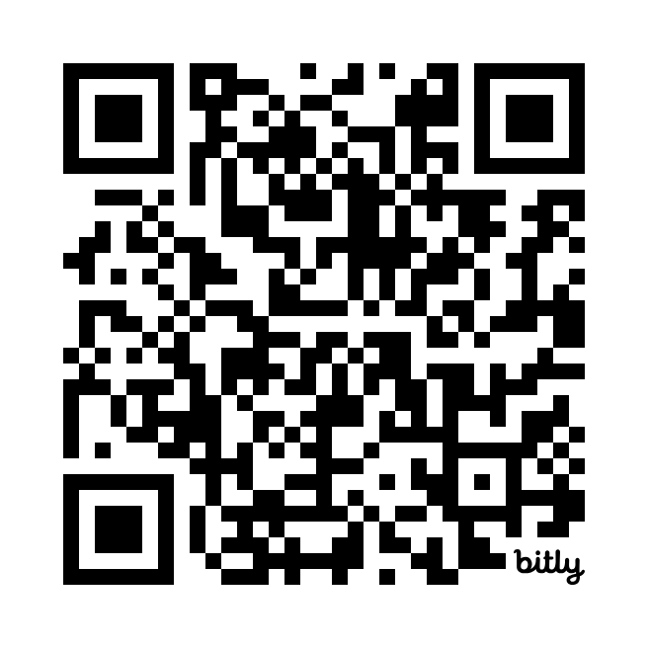
Pro Vision Basketball Price List
Monthly Pkg 1 | Monthly pkg 2 | Group sessions | Private sessions
3- Day Training Week (12 Sessions Total) Strength & Conditioning Basketball specific Footwork Development 1 hour Ages 13-18 | 2- Day Training Week (8 Sessions Total) Strength & Conditioning Basketball specific Footwork Development 1 hour Ages 13-18 | Basketball Skills Training 1 hour session Ages 13-18 | Basketball Skills Training Strength & Conditioning 1 hour sessions Ages 13-18
 |  |  | Basketball Skills Training Strength & Conditioning 1.5 hour sessions Ages 13-18
GROUP PKGS
PAY PER SESSION
Private Session #1
$75/Session
Monthly discount $280
(4 Sessions)
$480.00
$400.00
$60/Session
Private Session #2
$80/Session
Monthly discount $320
(4 Sessions)
CASHAPP
Schedule Training

